Slide 1

Cleaning our Data
Yelp Dataset Challenge
Follow our progress:
https://github.com/vanessailana/Machine_Learning_Projects-Fall-2019

Slide 2
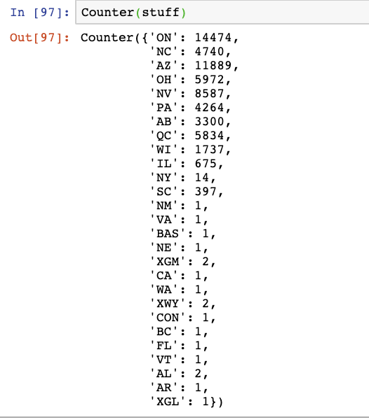
Business Table
Arizona is still the top contender for frequency of Food related businesses.

Slide 3
Cleaning Business Table
Approach
We were able to filter categories column and remove categories that had no association with Food. (Did this with looking of the frequency of words that appear in a category and with the help of our word cloud)
Found a list of cities in AZ (we were able to filter if the cities in the cities in the attributes are actually cities in AZ)
We filledNa for businesses that have null categories or attributes.
We filtered our data using data from AZ as previously stated.
Business outliers were removed with reviews of less than 63.
We filled in 0.5 for values that were not listed as true or false. (Even though its false, how do we know if its actually false the attribute)
We are using the text feature from the tip table.

Slide 4
Machine Learning Task #1
Generating recommendations for users of where to eat
Datasets we will be factoring in
tips .csv
Business.csv

Slide 5
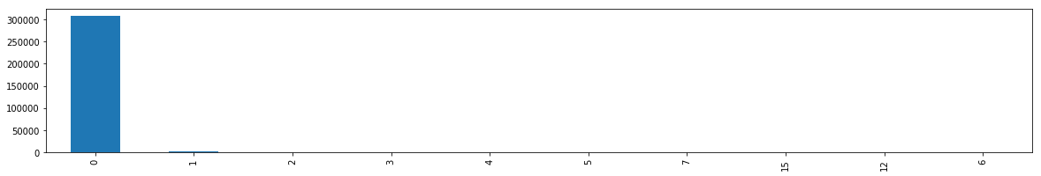
Tips Table
We removed compliment count (tips do not have a frequency of using this)

Slide 6
Text Preprocessing Approach
Tokenization
Tokenization Normalization
Stop Word Removal

Slide 7
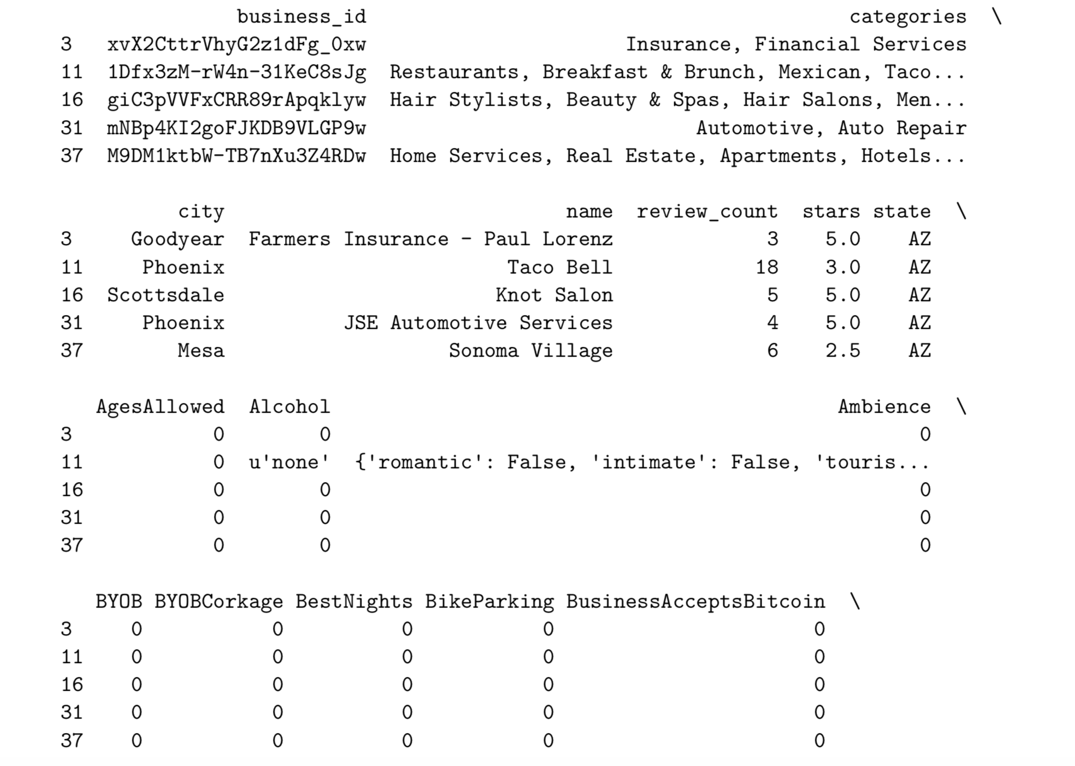
Example of how Business table is looking

Slide 8
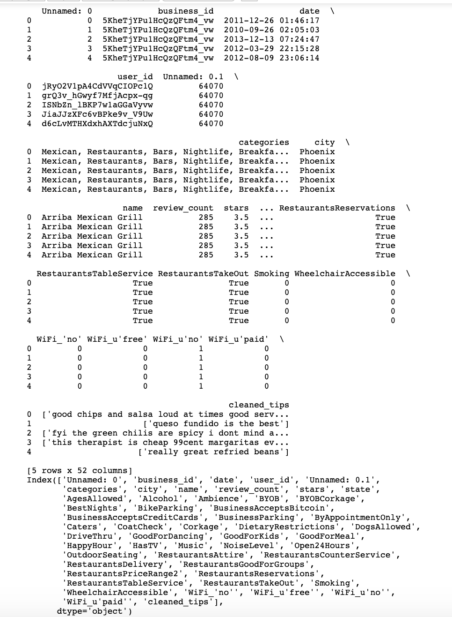

Slide 9
Whats next?
We went one step further of one hot encoding the attributes column to get the data in proper format.
When we move onto to the next step, we will have to go down even further and one hot certain columns that we got from the attributes column as they were nested jsons.
Categories we will go through break down this column in further.
We will take the cleaned tips and see if we can extract features

Slide 10
Machine Learning Task #2
Sentiment Analysis
What concerns a customer and what makes a good restaurant
Did a user like or not like a restaurant?
We will be taking the reviews table only into consideration. Maybe the business table to help give us an insight of where was the business and what is?

Slide 11
So, what did we do
We took a basic text preprocessing approach
We filled in NA for attributes that were missing values.
From the business table we are only factoring in the name of the business, so it can give us an insight of what the business is.

Slide 12
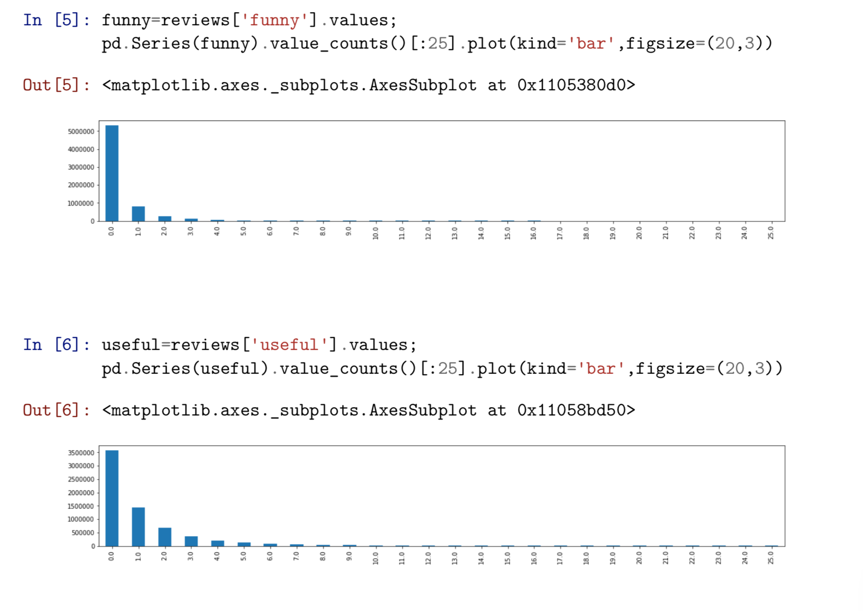

Slide 13
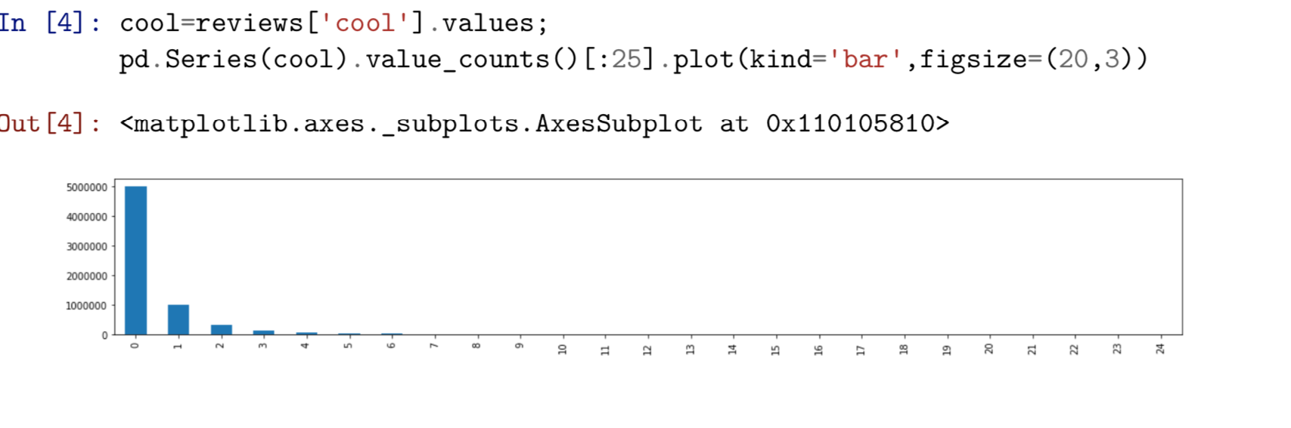

Slide 14
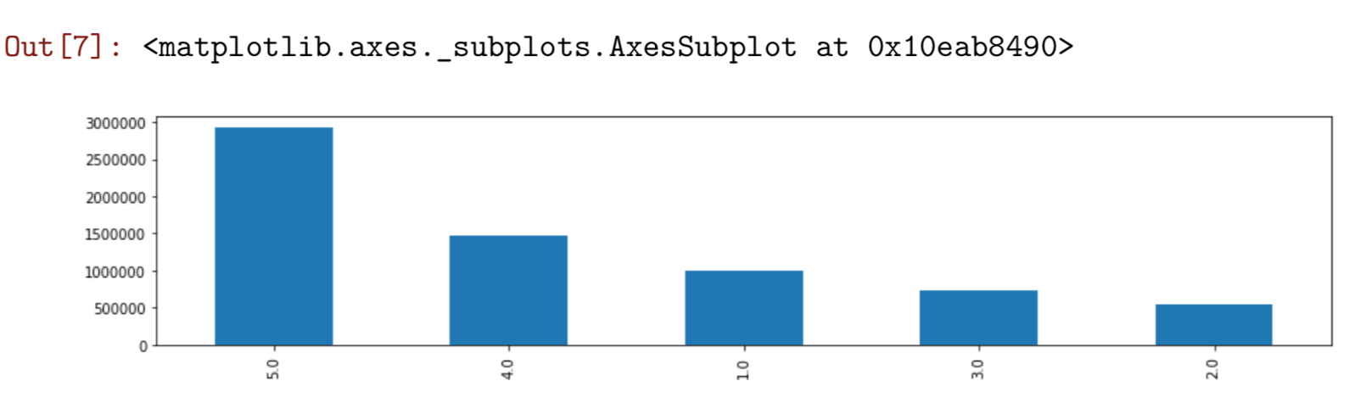

Slide 15
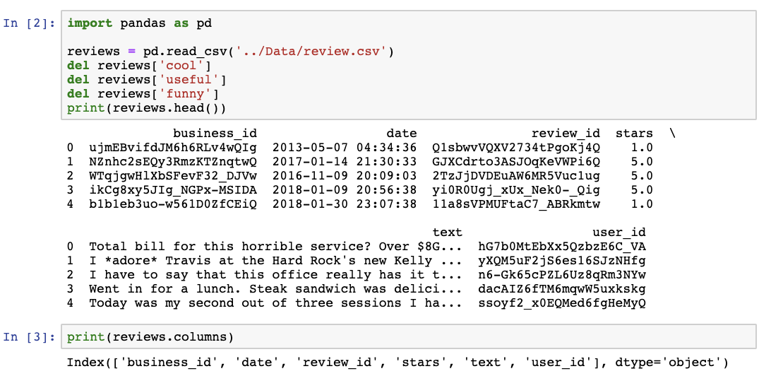

Slide 16
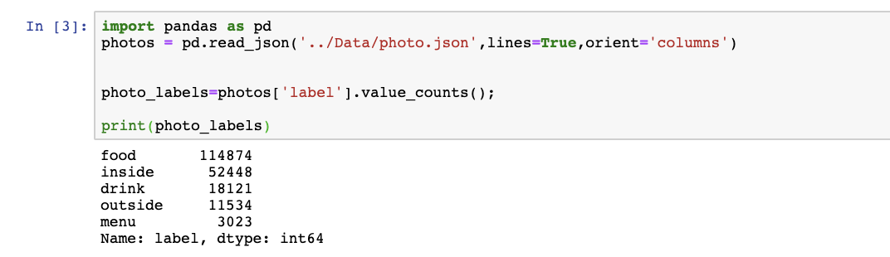
Photos: Just something extra.
Took photos associated them to the appropriate business)
Even though there is a low frequency of menu labels (still taking them into consideration)

Slide 17
Summing it up
We do not believe so far with how we are condensing our data we will have issues with our machine learning results. We are taking the appropriate considerations from filling in null values and handling outliers. The only thing, we are worried about is the text attributes. Text is not an easy thing to preprocess and it is hard to tell if taking this approach will be okay or not.

Slide 18
Fetch our data set
Data exploration and visualization
Move on the phase (formatting data to make it more consistent)
Head on to improving data quality (Data cleaning)
Feature engineering
Choose the model(s)
Train the model/evaluate
Parameter tuning
Let’s make predictions
What is Next?

